Slide 1




Sponsors for Global Azure Bootcamp
Thanks !

Slide 2
Azure HDInsight
- Azure Bootcamp -
2017. 4. 22
Ingyu Lee
(inlee@troy.edu)
https://github.com/Azure-Bootcamp-Troy/AzureHDInsight

Slide 3
Contents
Target Audience
Database / BI Professional.
Data Scientists / Analysts with some technical experience.
Prerequisites
Familiarity with database concepts and basic SQL query syntax.
Basic understanding of Unix commands.
Familiarity with programming fundamentals.
Outline
P1: Getting Started with HDInsight.
P2: Processing Big Data with Hive.
P3: Going Beyond Hive with Pig and Python.
P4: Using HBase for NoSQL Data
Hands-on Labs
Free trial available.
Microsoft Azure Subscription.
edX (Microsoft)
DAT202.1x Processing Big Data with Hadoop in Azure HDInsight
DAT202.2x Implementing Real-Time Analytics with Hadoop in Azure HDInsight
DAT202.3x Implementing Predictive Analytics with Spark in Azure HDInsight
MVA (Microsoft Virtual Academy)
Big Data Analytics with HDInsight
Implementing Big Data Analysis Jump Start
Coursera (Big Data Specialization)
Hadoop Platform and Application Framework
Introduction to Big Data Analytics

Slide 4
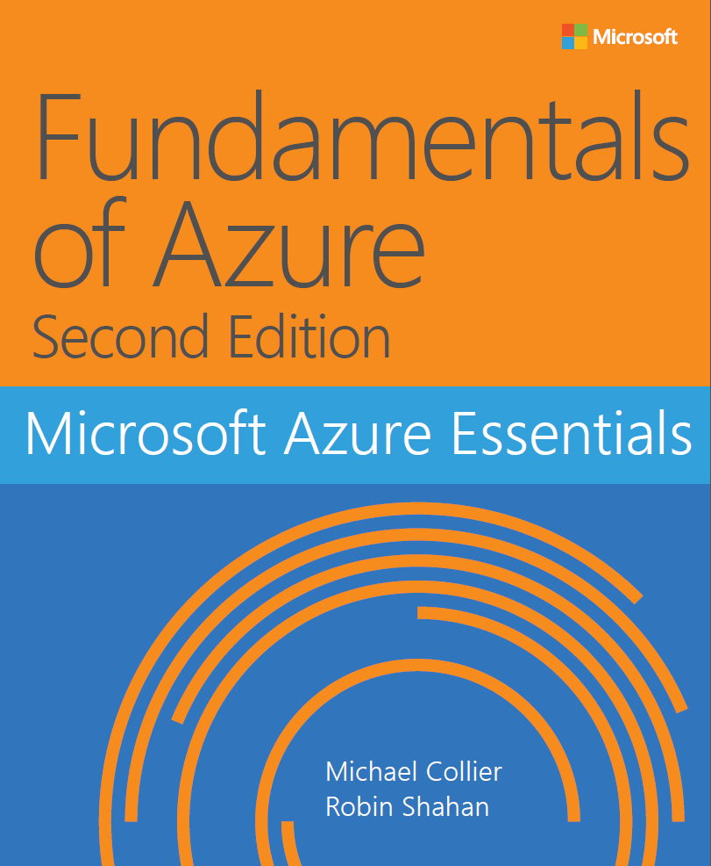
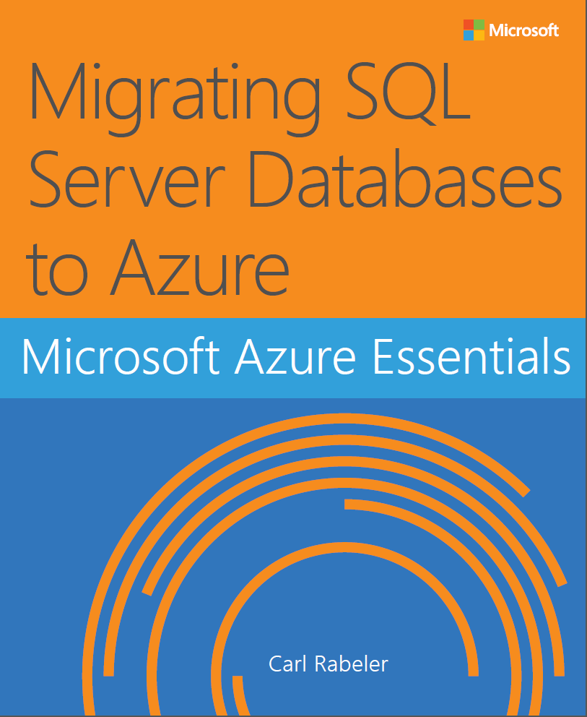
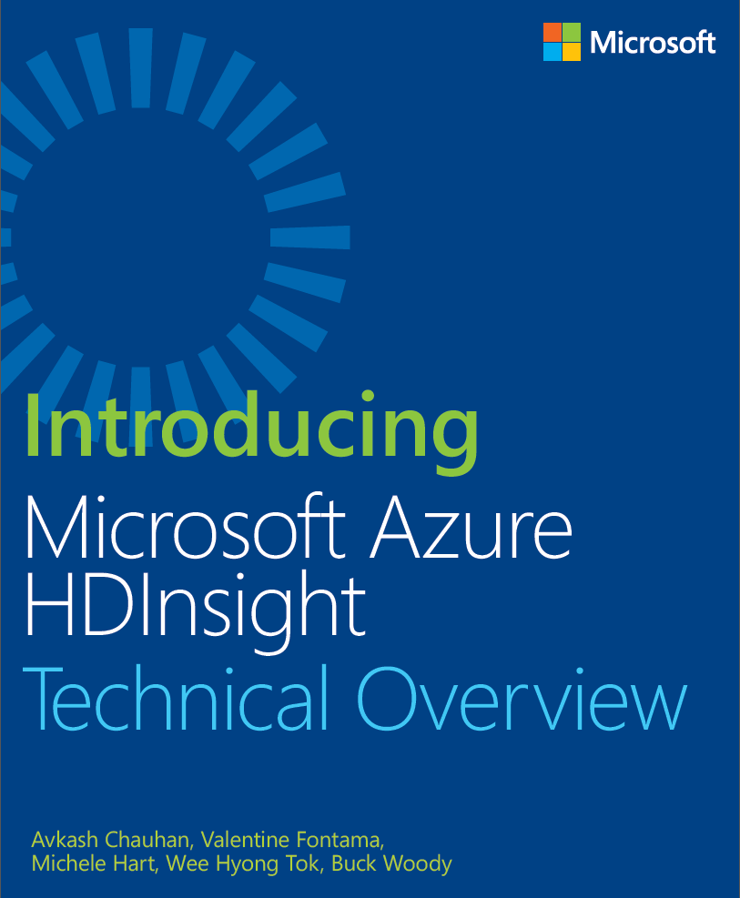
Free eBooks
http://www.microsoftvirtualacademy.com/ebooks

Slide 5
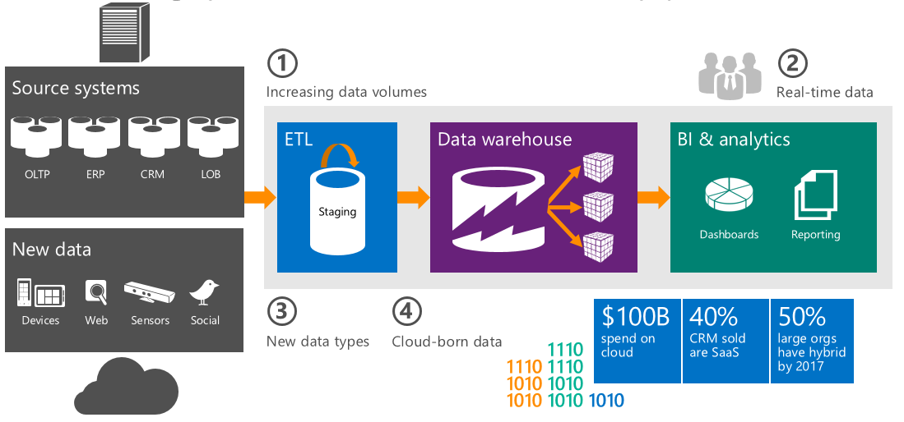
I Introduction to Big Data and HDInsight
1. What is Big Data?
Data that is too large or complex for analysis in traditional relational databases.
Typified by the “3 Vs”
Volume: Huge amounts of data to process.
Variety: A mixture of structured and unstructured data.
Velocity: New data generated extremely frequently.
Breaking Point of Traditional Approach

Slide 6
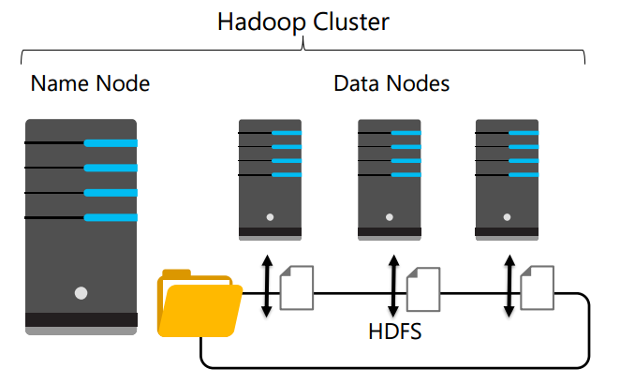
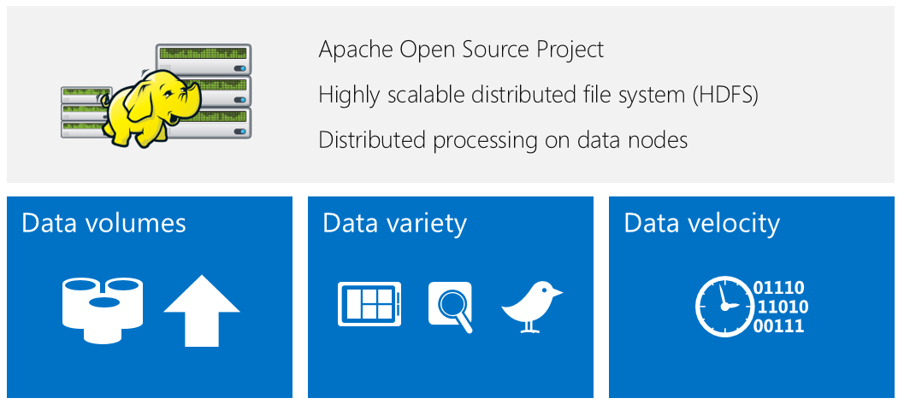
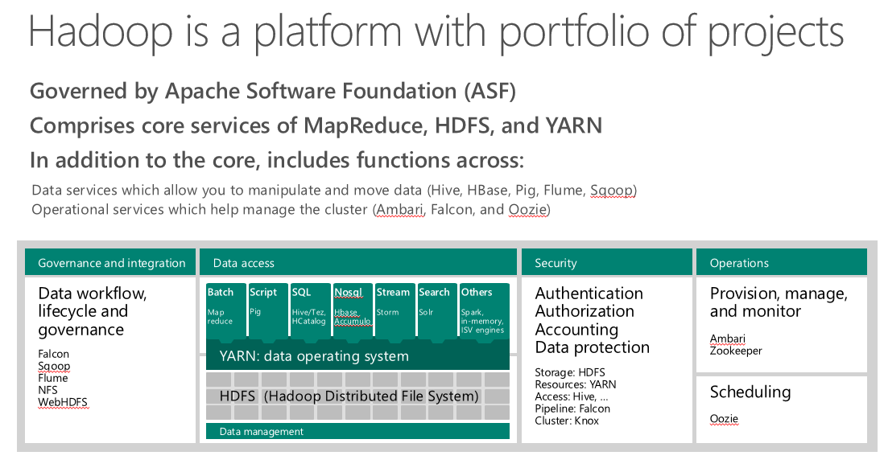
I Introduction to Big Data and HDInsight: What is Hadoop?
What is Hadoop?
Open source distributed data processing cluster.
Data processed in Hadoop Distributed File System (HDFS).
Resource Management is performed by YARN.

Slide 7
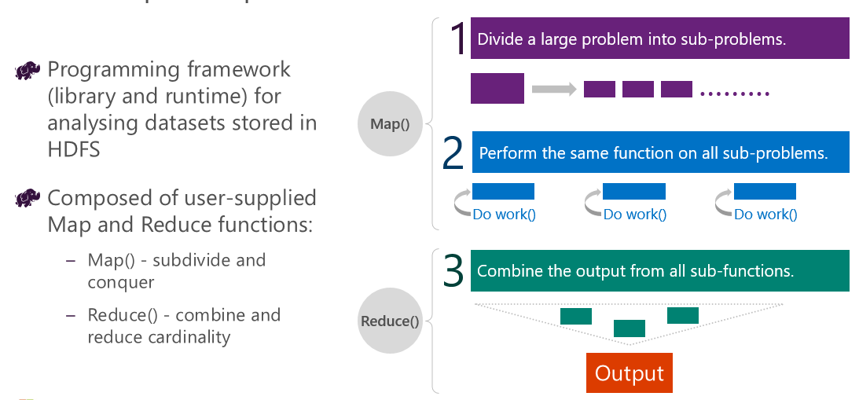
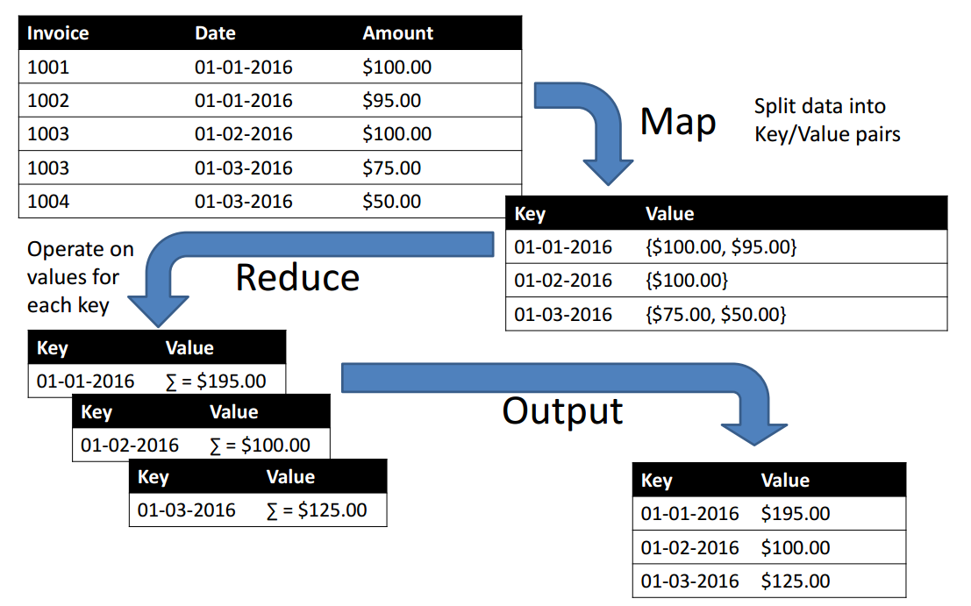
I Hadoop MapReduce

Slide 8
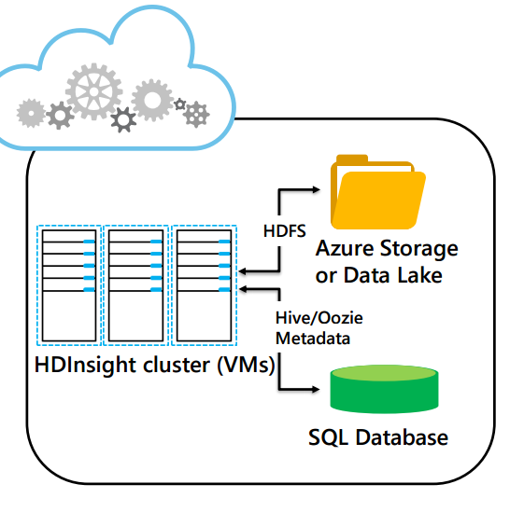
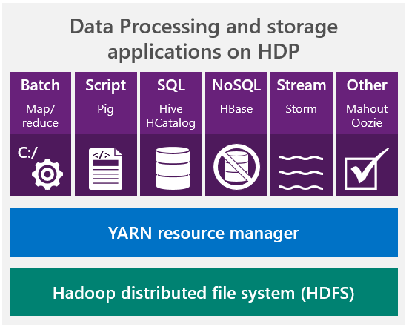
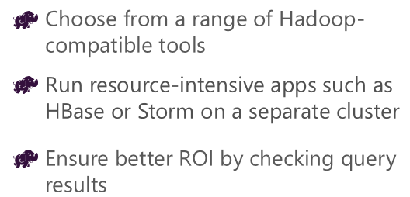
I Introduction to Big Data and HDInsight
What is HDInsight?
Apache Hadoop on Azure
Hortonworks HDP on Azure VMs.
Azure Storage or Azure Data Lake provides the HDFS layer.
Azure SQL Database stores metadata.
Demo: Provisioning an HDInsight Cluster

Slide 9
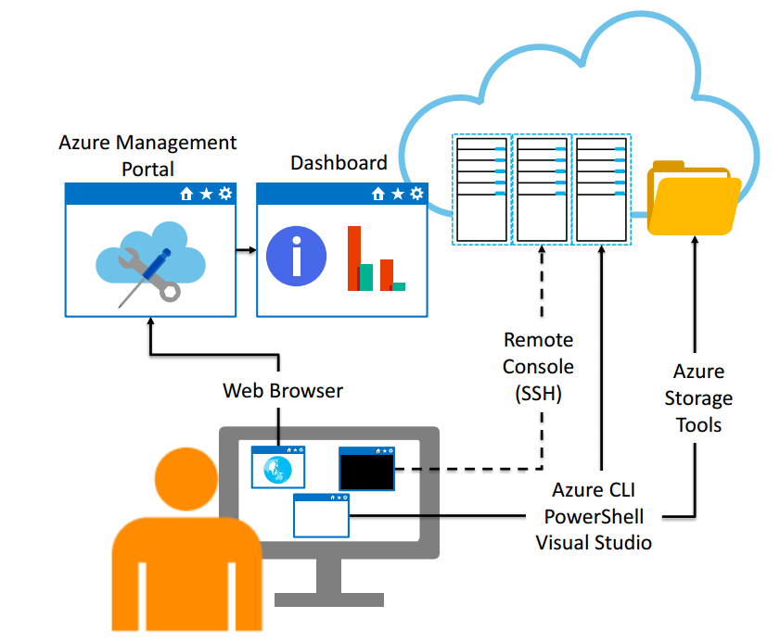
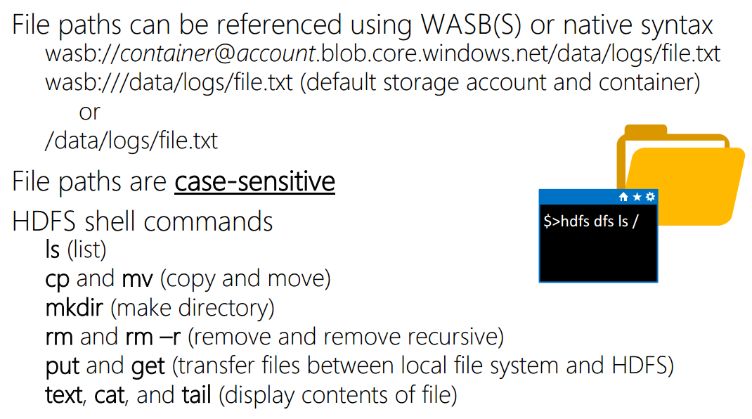
I HDInsight: What client tools can I use?
Demo: Using HDInsight Client Tools in Windows

Slide 10
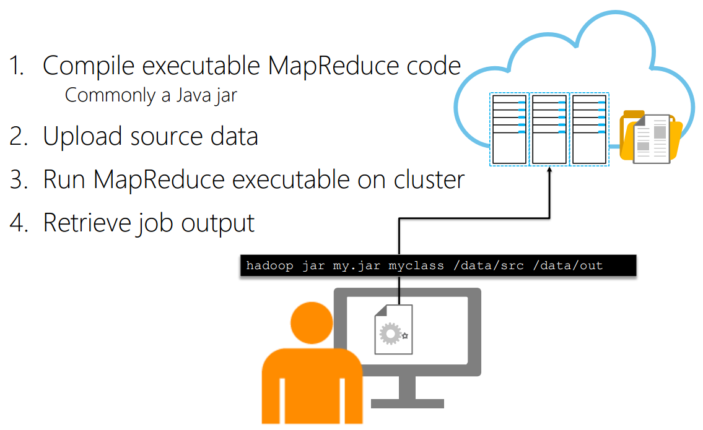
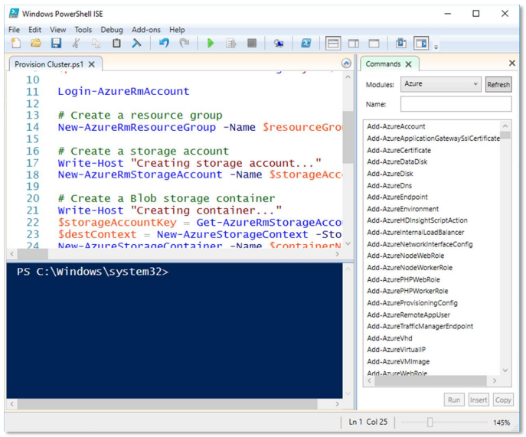
I HDInsight: How do I Run a MapReduce Job
Demo: Run a MapReduce Job from Windows
The Azure PowerShell module includes cmdlets to work with Azure services, including HDInsight
Use PowerShell to
Provision HDInsight Clusters
Upload/download files
Submit jobs
Manage cluster resources
Demo: Using PowerShell with HDInsight

Slide 11
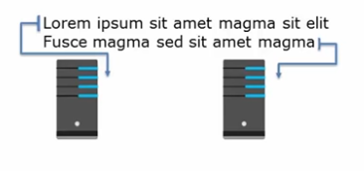
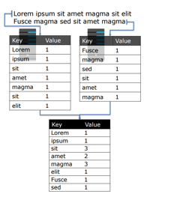
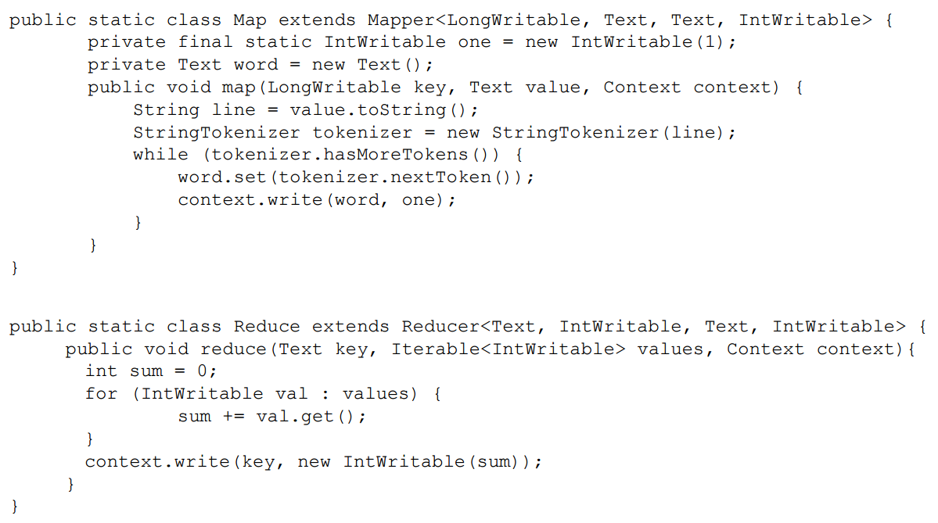
I Introduction to Big Data and HDInsight: Example
Word Count (The “Hello World” of MapReduce)
Source text is divided among data nodes.
Map phase generates key/value pairs with words as keys and placeholder values of 1.
Reduce phase aggregates values for each key by adding the values for each word.

Slide 12
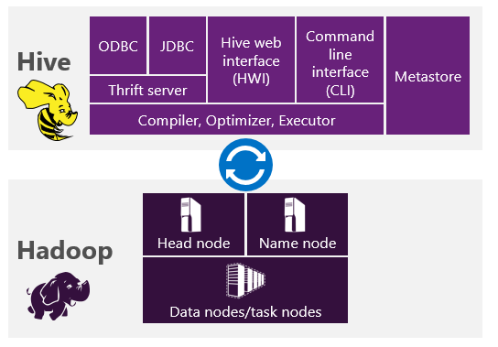

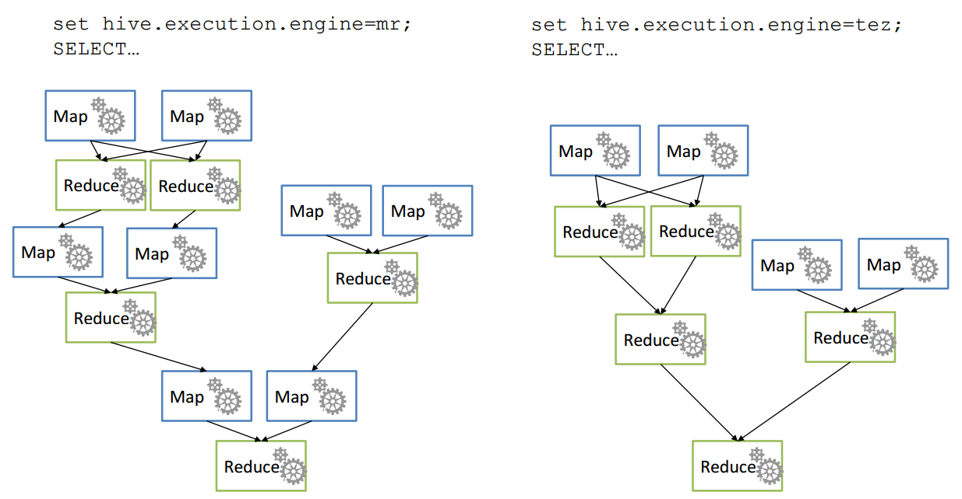
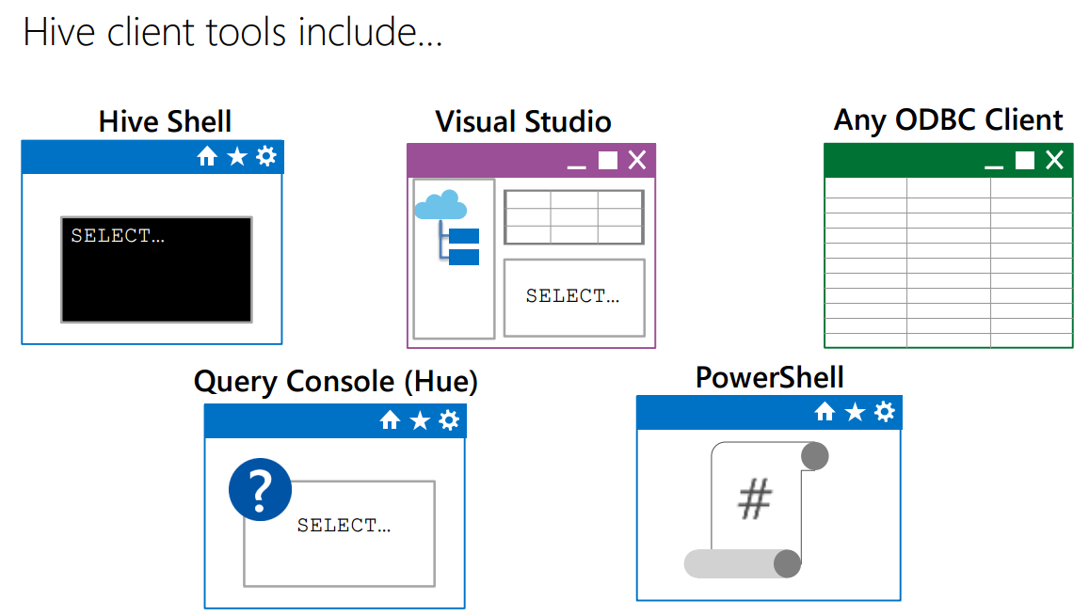
II Processing Big Data with Hive: What is Hive?
Apache HIVE is a data warehouse system for Hadoop.
A metadata service that projects tabular schemas over folders.
Enables the contents of folders to be queried as tables, using SQL-like query semantics, HiveQL.
Queries are translated into jobs
Execution engine can be Tez or MapReduce
MapReduce vs. Tez

Slide 13
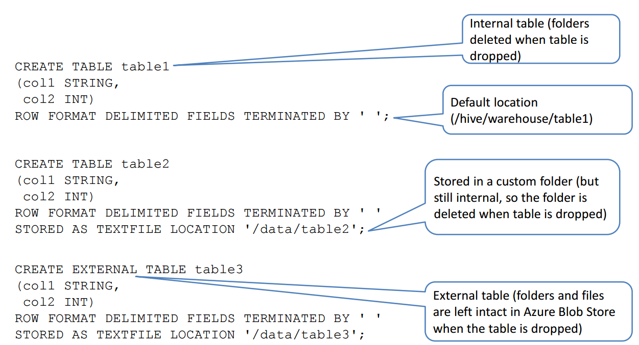
II Hive: How do I create and load Hive tables?
Use the CREATE TABLE HiveQL statement
Defines schema metadata to be projected onto data in a folder when the table is queried (not when it is created)
Specify file format and file location
Defaults to textfile format in the <database>/<table-name> folder
Default database is in /hive/warehouse
Create additional databases using CREATE DATABASE
Create internal or external tables
Internal tables manage the lifetime of the underlying folders
External tables are managed independently from folders

Slide 14
II Hive: Hive data types
Numeric
Integers: TINYINT, SMALLINT, INT, BIGINT
Fractional: FLOAT, DOUBLE, DECIMAL
Character
STRING, VARCHAR, CHAR
Date/Time
TIMESTAMP
DATE
Special
BOOLEAN, BINARY, ARRAY, MAP, STRUCT, UNIOTYPE
1. Save data files in table folders (or create table on existing files!)
PUT myfile.txt /data/table1
2. Use the LOAD statement
LOAD DATA (LOCAL) INPATH ‘/data/source’ INTO TABLE MyTable;
3. User the INSERT statement
INSERT INTO TABLE Table2
SELECT Col1, UPPER(Col2)
FROM Table1;
4. Use a CREATE TABLE AS SELECT (CTAS) statement
CREATE TABLE Table3
ROW FORMAT DELIMITED FIELDS TERMINATED BY ‘\t’
STORED AS TEXTFILE LOCATION ‘/data/summarytable’
AS
SELECT Col1, SUM(Col2) As Total
FROM Table1
GROUP BY Col1;
Demo: Creating Hive Tables

Slide 15
II Hive: How do I query Hive Tables?
1. Query data using the SELECT HiveQL statement
SELECT Col1, SUM(Col2) AS TotalCol2
FROM MyTable
WHERE Col3 = ‘ABC’ AND Col4 < 10
GROUP BY Col1
ORDER BY Col4;
2. Hive translates the query into jobs and applies the table schema to the underlying data files
3. Views are named queries that abstract underlying tables
CREATE VIEW vSummarizeData
AS
SELECT col1, SUM(col2) AS TotalCol2
FROM mytable
GROUP BY col1;
SELECT col1, TotalCol2
FROM vSummarizeData
Demo: Querying Hive Tables

Slide 16
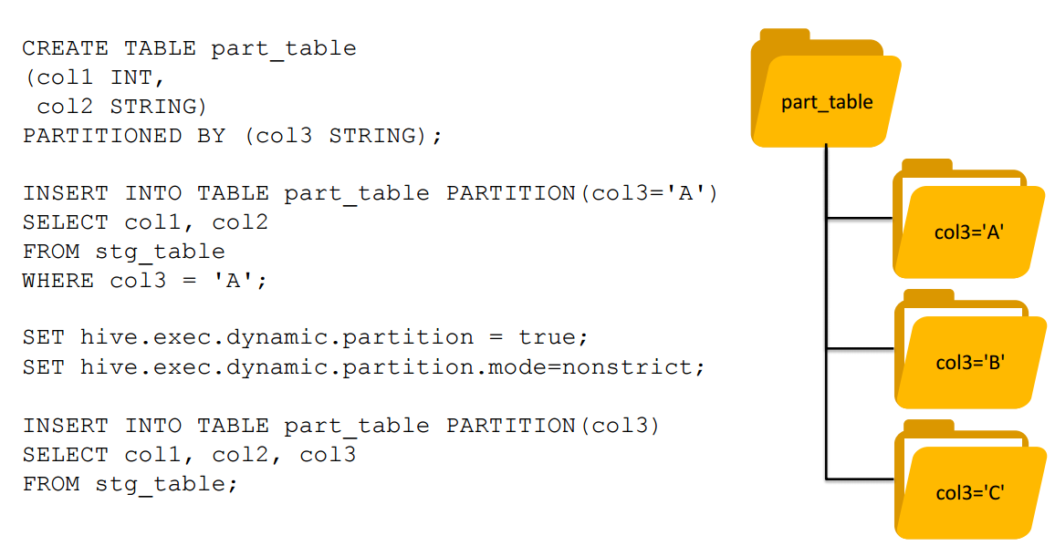
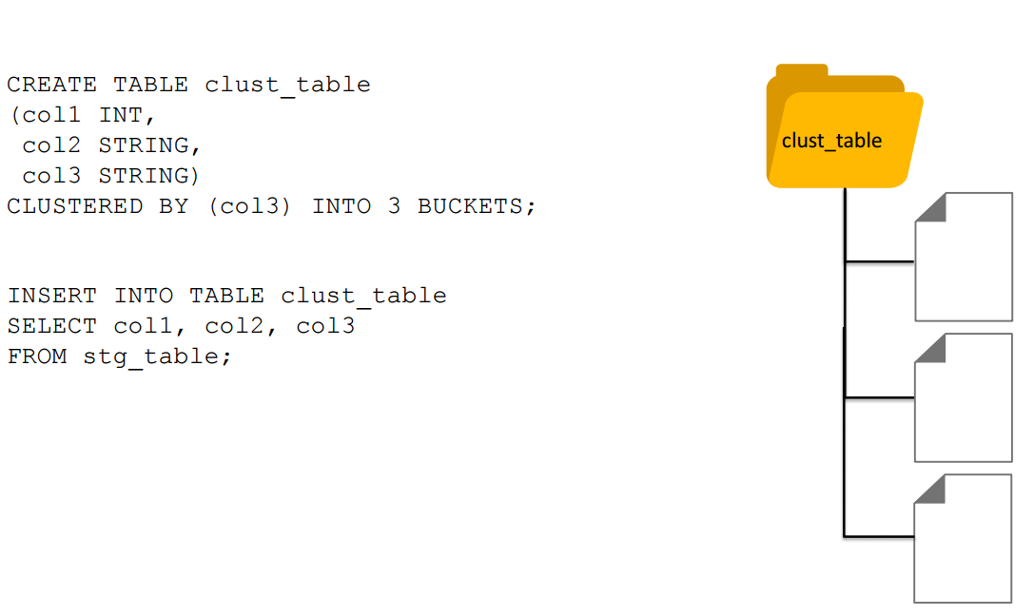
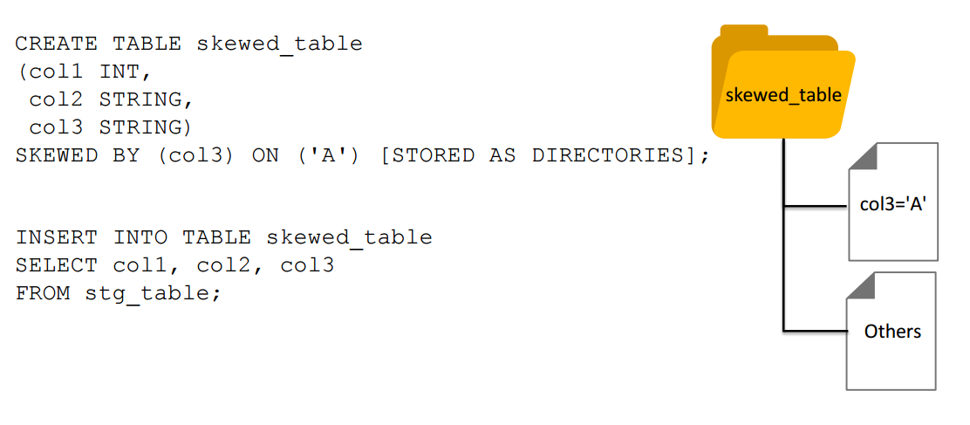
II Hive: Partitioning, Skewing, and Clustering Tables
Demo: Creating Partitioned Tables

Slide 17
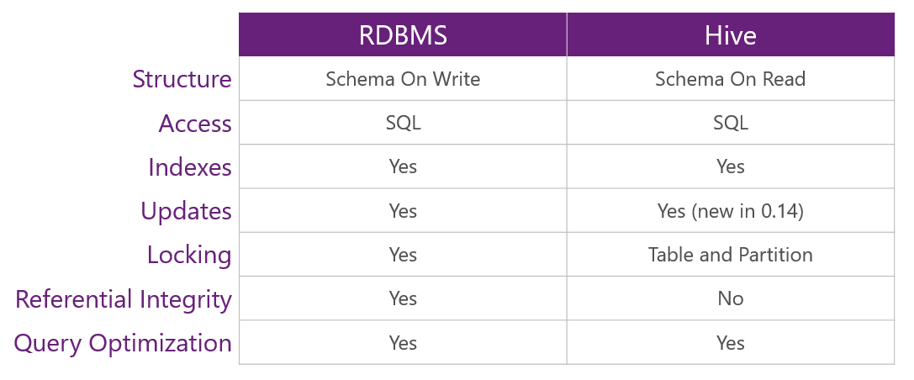
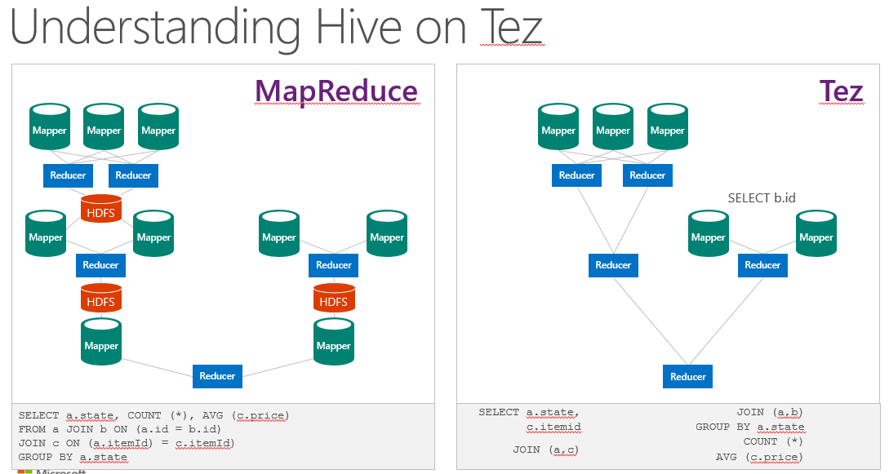
II Hive Comparing RDBMS and Hive

Slide 18
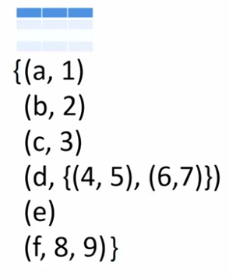
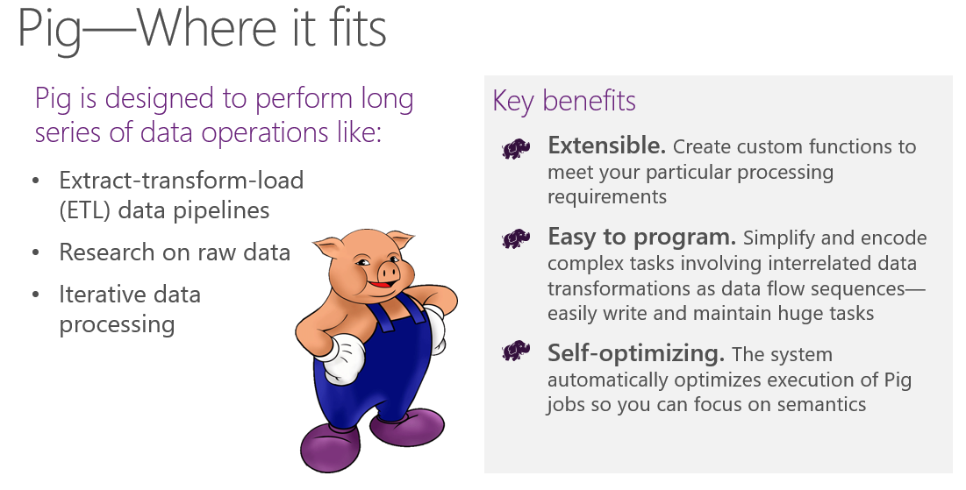
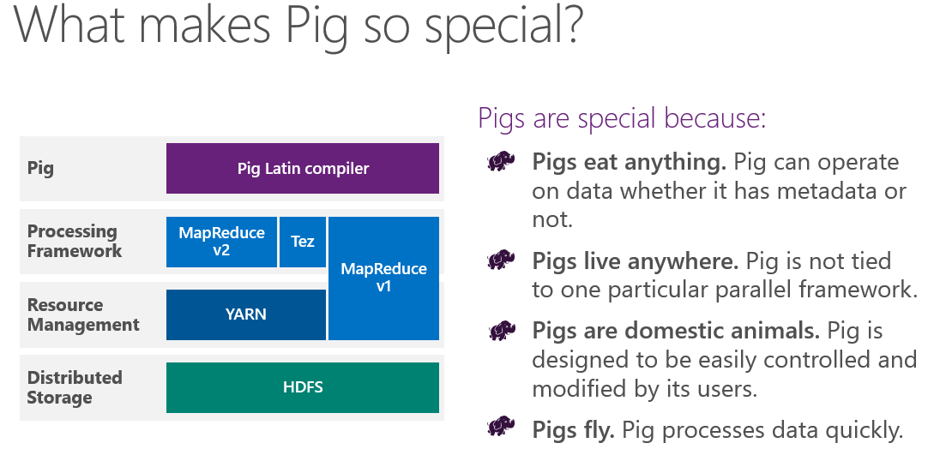
III Beyond Hive: What is Pig?
Pig is a high level scripting language used with Hadoop.
Pig performs a series of transformations to data relations based on Pig Latin statements.
Relations are loaded using schema on read semantics to project table structure at runtime.
You can run Pig Latin statements interactively in the Grunt shell or save a script file and run them as a batch.
A relation is an outer bag
A bag is a collection of tuples
A tuple is an ordered set of fields
A field is a data item
A field can contain an inner bag
A bag can contain tuples with nonmatching schema

Slide 19
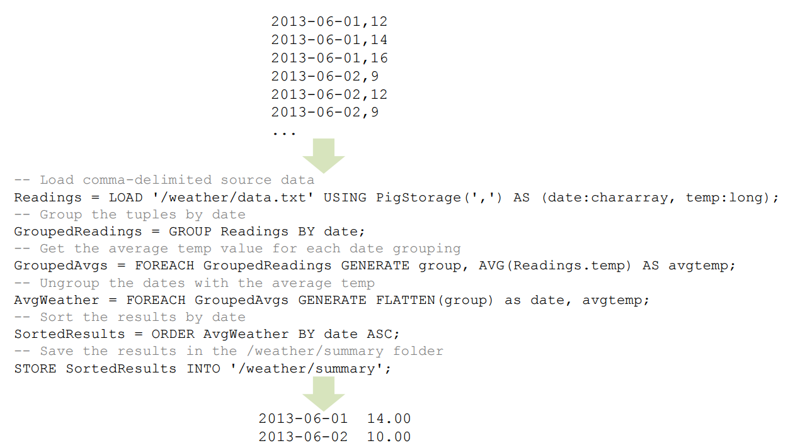
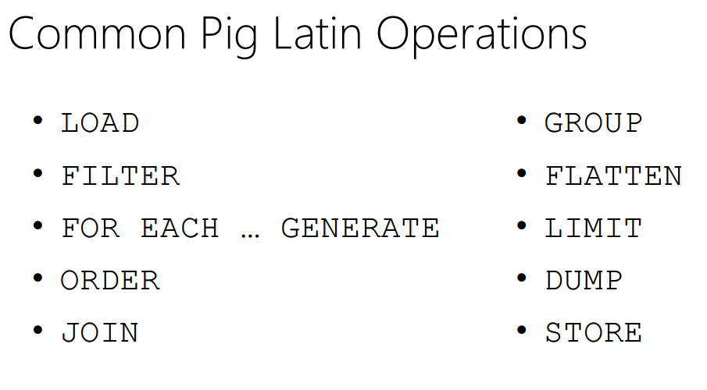
III Pig: What kinds of things can I do with Pig?
Date, temperature

Slide 20
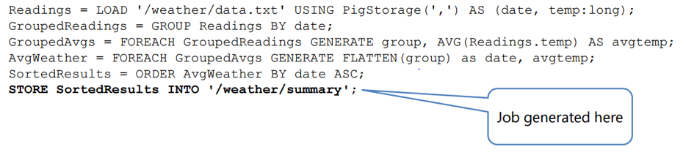
III Pig: What kinds of things can I do with Pig?
Pig generates Map and Reduce operations from Pig Latin
Jobs are generated on:
DUMP
STORE
Demo: Processing Data with Pig

Slide 21
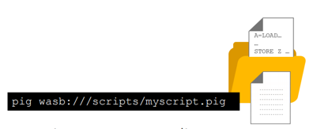

III Pig: How do I run a Pig script?
Save a Pig Latin script file
Run the script using Pig
Pig wasb:///scripts/myscript.pig
Consume the results using any Azure storage client
For example, Excel or Power BI
Default output does not include schema – just data
Demo: Running a Pig Script

Slide 22
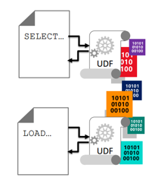
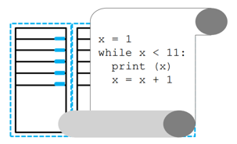
III Pig: What are UDFs?
User Defined Functions (UDFs) extend the capability of Hive and Pig
Simpler than writing custom MapReduce components
Can be implemented using many languages, for example:
Java
C#
Python
Python is a (relatively) simple scripting language – ideal for UDFs
Intuitive syntax
Dynamic typing
Interpreted execution
Python is pre-installed on HDInsight clusters
Python 2.7 supports streaming from Hive
Jypthon (a Java implementation of Python) has native support in Pig

Slide 23
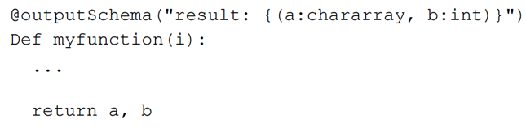
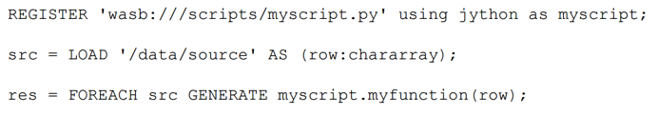
III Pig: How do I use a Python UDF in Pig?
Pig natively supports Jython
Define the output schema as a Pig bag
Declare a Python function that receives an input parameter from Pig
Return results as fields based on the output schema
2. Use the Pig FOREACH…GENERATE statement to invoke a UDF
Demo: Using a Python UDF from Pig

Slide 24
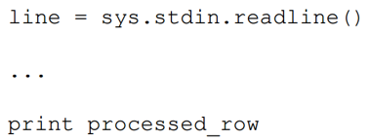
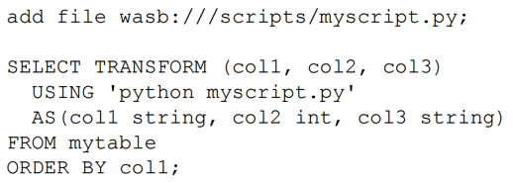
III Pig: How do I use a Python UDF in Hive?
Hive exchanges data with Python using a streaming technique
Rows from Hive are passed to Python through STDIN
Processed rows from Python are passed to Hive through STDOUT
2. Use the Hive TRANSFORM statement to invoke a UDF
Demo: Using a UDF from Hive

Slide 25
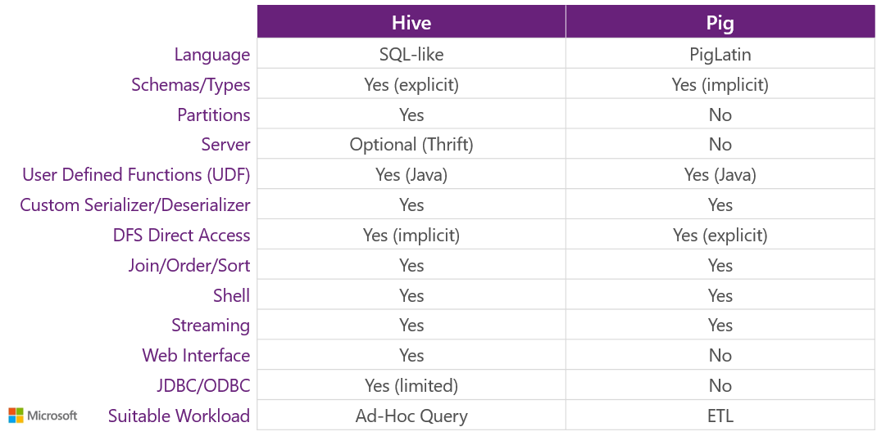
III Hive and Pig – Complementing each other

Slide 26
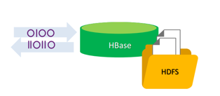
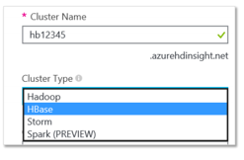
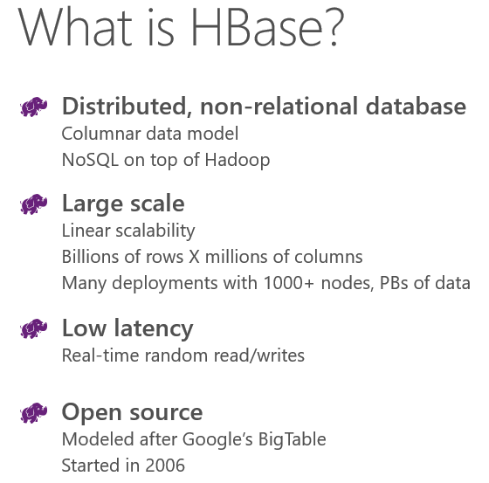
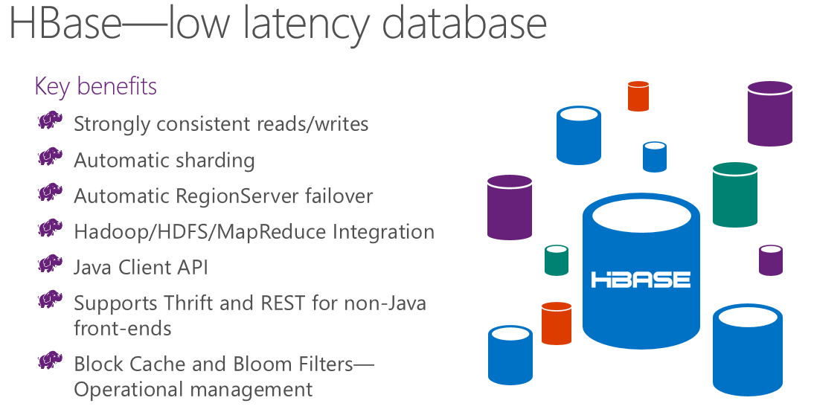
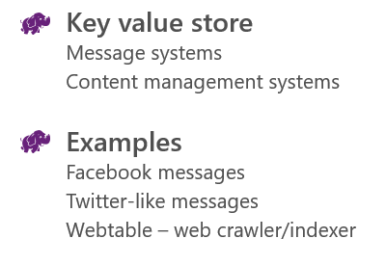
IV HBase: What is Apache HBase?
A low-latency, NoSQL database built on Hadoop.
Modeled on Google’s Big Table.
HBase stores data in StoreFiles on HDFS.
HDInsight supports an HBase cluster type
Choose Cluster Type in the Azure Portal.
Can be provisioned in a virtual network.

Slide 27
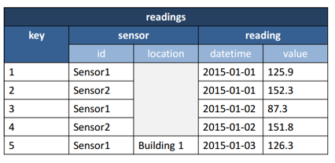
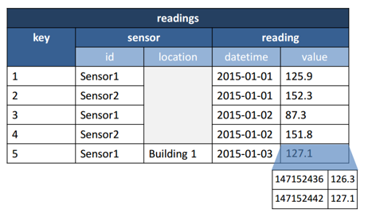
IV HBase: How Does HBase Store Data?
Data is stored as key-value pairs.
Table schema arranges values into column families.
Column family schema is flexible.
Columns are row-specific.
Cells in a table are versioned.
Each versioned cell value is indicated by a timestamp.

Slide 28
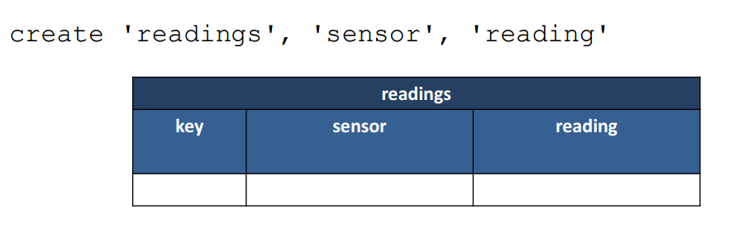





IV HBase: How Do you work with an HBase Table?

Slide 29


IV HBase: How Do you work with an HBase Table?

Slide 30


IV HBase: How Do you work with an HBase Table?

Slide 31



IV HBase: How Do you work with an HBase Table?
Demo: Working with HBase Tables

Slide 32


IV HBase: How to use HBase with Hive?
How Do you Bulk Load Data into HBase?
Upload data to HDFS
In Azure Storage
Import into a StoreFile
Load the StoreFile to an HBase table
How Do You Query HBase Tables from Hive?
Demo: Bulk Loading HBase Tables

Slide 33


IV Sqoop: What is Sqoop?
Sqoop is a database integration service
Built on open source Hadoop technology
Enables bi-directional data transfer between Hadoop clusters and databases via JDBC
Basic syntax
sqoop command --arg1, --arg2, …, --argN
3. Commands
import / export
help
import-all-tables
create-hive-tables
list-databases / list-tables
eval
codegen
version

Slide 34
IV Sqoop: How do I run Sqoop commands?
sqoop import
--connect jdbc-connection-string
--username user-name --password password | -P
--table table-name --columns col,…,colN | --query ‘SELECT…’
--warehouse-dir | --target-dir path
--fields-terminated-by char --lines-terminated-by char
--hive-import [--hive-overwrite]
-m | --num-mappers number-of-mappers
sqoop export
--connect jdbc-connection-string
--username user-name --password password | -P
--table table-name
--export-dir path
--fields-terminated-by char --lines-terminated-by char
-m | --num-mappers number-of-mappers
Demo: Using Sqoop from windows

Slide 35



IV: Oozie and Mahout

Slide 36

Q and A

